Slide 1

College Expectations
CSM PRESS 2025

Slide 2
SCHEDULE
Voluntary
You may have long gaps between classes
You manage your own time
No homework doesn’t mean no studying
Expected to seek assistance outside of instructional time

Slide 3
INSTRUCTIONAL TIME
15-week term
Classes meet 2-3 times a week
Attendance may or may not be mandatory
Expected to do much more outside of class
Expected to visit office hours for assistance
Class format vary greatly

Slide 4
FACULTY
Studied content and possibly pedagogy
May have research obligations
May be on campus only a few hours each day
Syllabus!!
Assumes you are prepared
Absences are your responsibility, not theirs.
Available to help, but expect you to seek assistance

Slide 5
TESTS
May only have 2 or 3 tests
May earn a zero if you miss a test
Test dates fixed and published in syllabus
Know the makeup exam policy
Apply the concepts you’ve learned in new situations
Synthesize the content and pick out what’s important

Slide 6
GRADES
Assumed you did the work/reading
Extra credit opportunities are rare
Results count, not effort
May only have a few assignments with heavy weights

Slide 7
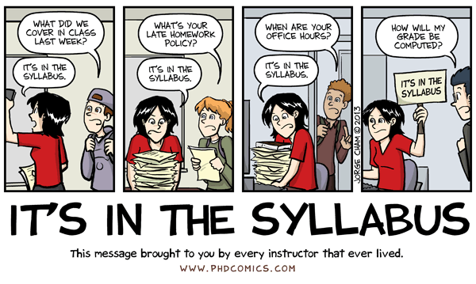
Syllabus comic strip

Slide 8
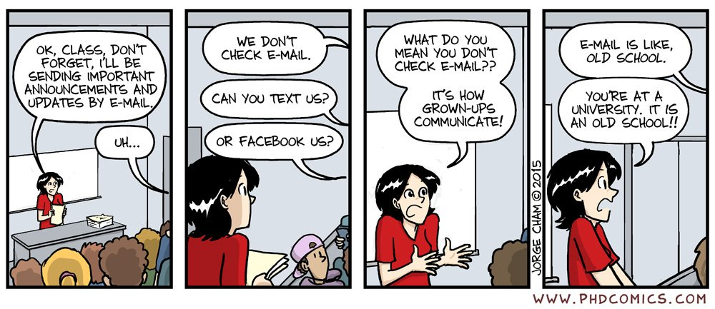
Email comic strip

Slide 9
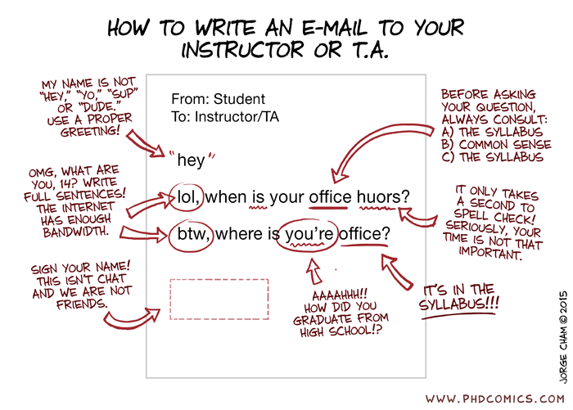
How to write an email

